Slide 1
Economic Impact of the HEMS Weather Tool Chris Eastlee

Slide 2
Economic Impact of the HEMS Weather Tool
HEMS WX Tool is both a line pilot resource and a critical aviation management component.
EVERY HEMS Operational Control Center (OCC or EOC) currently relies on the WX Tool for accurate “No Go” WX decisions.
OCC’s a major component of the modern HEMS transport system.

Slide 3
Economic Impact of the HEMS Weather Tool
FAA will require OCC’s in upcoming HEMS Final Rule.
OCC’s will be required to monitor weather conditions, inform pilots.
HEMS WX Tool is the ONLY weather resource of its kind.
Therefore, costs of requiring OCC’s must include VALUE of tool to the requirement.

Slide 4
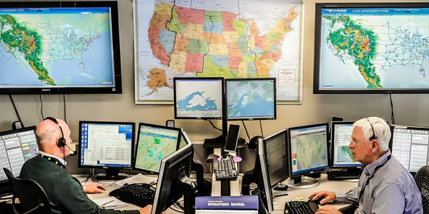
Economic Impact of the HEMS Weather Tool

Slide 5
Economic Impact of the HEMS Weather Tool
Proposed Rule | FAA Estimate | Industry Estimate
Communications equipment | N/A | $1,152,000
Computer equipment | $1,152,000 | $1,152,000
Satellite tracking equipment X 989 | N/A | $9,890,000
Installation incl. time out of service (10 days) at $12,000 (cost per day) X 989 Aircraft | N/A | $118,680,000
Software (development, 1st year) | N/A | $2,000,000
Total Initial Installation Costs: | $1,152,000 | $132,874,000
Location costs (per year) | N/A | $36,000
Software Maintenance (per year) | N/A | $200,000
Total Recurring Costs (10 years): | N/A | $2,360,000

Slide 6
Economic Impact of the HEMS Weather Tool
OCC’s costs exceed $135 Million over 10 years (estimate, not including staffing/training costs).
No commercial product available similar to HEMS WX Tool.
WX Tool has created a standard through OCC requirement making it irreplaceable from a regulatory perspective.
Value of HEMS WX Tool to Required OCC Operation: ?
Total HEMS WX Tool Value: ???

Slide 7
Economic Impact of the HEMS Weather Tool
DOT Value of Statistical Life (VSL) for 2013 $9.1 Million;
accident fatality prevention valued greater than 9.1 X 3-4 in HEMS
“The Socio-Economic Value of Improved Weather and Climate Information “ (Williamson, Hertzfeld, Cordes; Space Policy Institute, The George Washington University, 2002 http://www.gwu.edu/~spi)
Reduced costs to airline and trucking industry:
$160-175 Million Annually (for ENSO Prediction)
Benefits from Enhanced GOES-R Satellite Predictions:
$41 Million for Commercial Aviation

Slide 8
HEMS Industry Representatives
HEMS Weather Summit 2013 Industry Representatives
Name | Email | Phone
Chris Baur | Chris.Baur@hughesaerospace.com | 281-591-4729
Chris Eastlee | ceastlee@airmedicaloperators.com | 219-743-3188
Colin Henry | chenry@medflight.com | 614-734-8047
Don Mynard | dmynard@phihelico.com | 480-773-4130
Ed Stockhausen | estockhausen@airmethods.com | 303-792-7400
Eric Lugger | ericlugger@gmail.com | 281-678-1823
Gerald Pagano | gpagano@hcdpbc.org | 561-719-6704
J Heffernan | j.heffernan@rotor.org | 703-683-4646 x1605
Matt Johnson | matt@mattjohnsonhelicfi.com | 513-678-4197
Neal Jacobs | neal1958@gmail.com | 206-372-2320
Ralph Petragnani | rpetragnani@belfortinstrument.com | 443-983-2726
Rex Alexander | rex@heliexp.com | 260-494-0891
Thomas Judge | tjudge@ahs.emh.org | 207-973-6706

