Slide 1
Real-Time Mesoscale Analysis Review and Plans for Rapid Updating Analysis
NextGen Weather Program

Slide 2
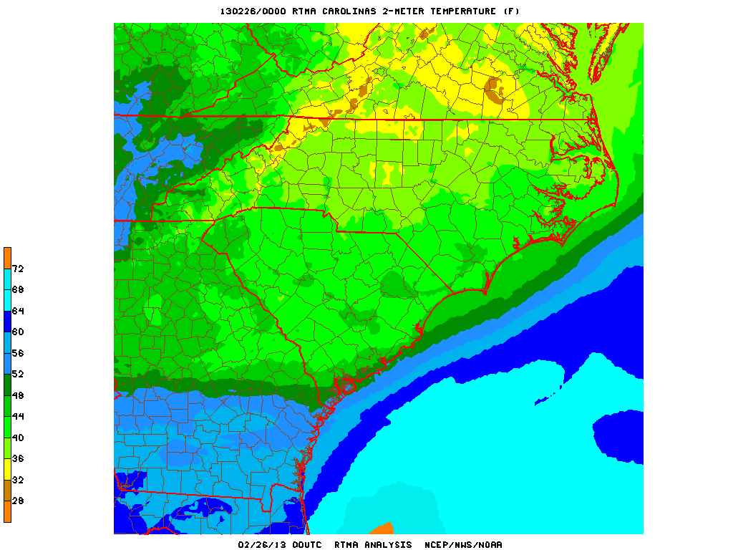
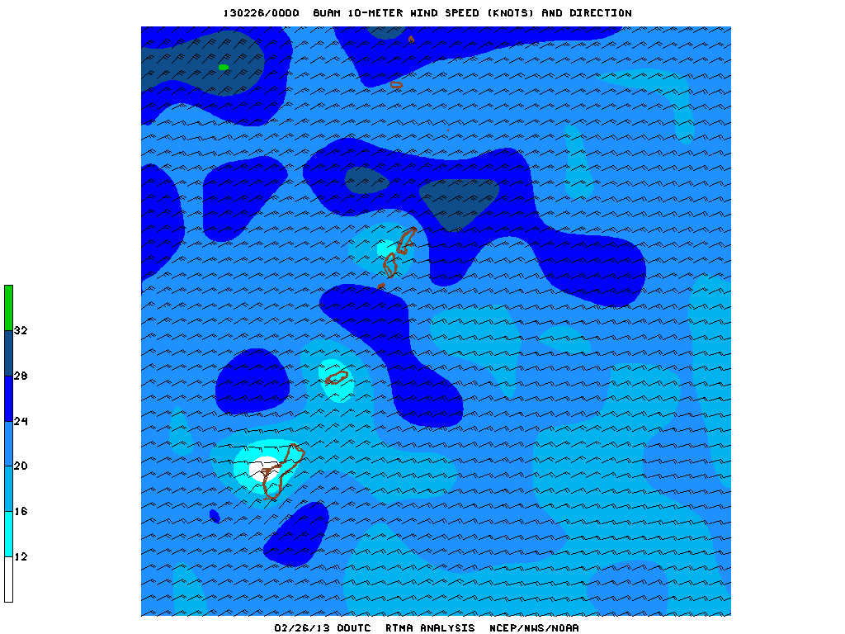
What is RTMA?
RTMA: Real-Time Mesoscale Analysis
A 5 km to 2.5 km hourly CONUS gridded weather analysis
Provides gridded initial conditions for local forecasts for NWS field offices
Also used as the “Analysis of Record” (AOR) for forecast verification and case studies

Slide 3
RTMA Details
Analyses:
Wind Speed and Direction
Temperature
Dew Point Temperature
Surface Pressure
Effective Cloud Amount
Accumulated precipitation
Analysis Uncertainty:
Temperature
Dew Point Temperature
Wind Speed
Wind Direction
Model Terrain:
Fixed field
Hourly Domains:
CONUS (5 and 2.5 km)
Hawaii (2.5 km)
Alaska (6 km)
Puerto Rico (2.5km)
3 hourly Domain:
Guam (2.5km)

Slide 4
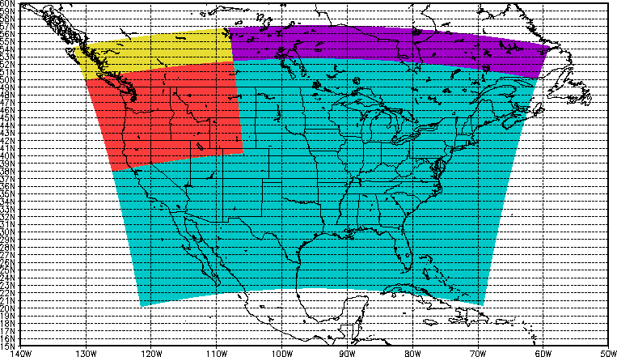
2013 RTMA Enhancements
3 km Analysis upgrade for Alaska
1.5 KM Analysis domain for Juneau
2.5 km Analyses for Northwest RFC domain
Science and quality control technique improvements:
Improved handling of snowpack in RAP
Winds from Hurricane WRF added to improve analyses of tropical cyclones
New analysis variables:
Wind gusts
Visibility

Slide 5
Next Steps for RTMA Development
Explore potential for additional Aviation impact analysis variables:
Total cloud cover
Cloud base heights
Mean sea level pressure
Continue to enhance quality control of observations:
Real-time monitoring system
Real-time data mining
Add metadata into GSI
Improved Land sea mask
Unrestricted Mesoscale Analysis:
Run 4 hours after RTMA
Collects more complete set of observations
Improved product verification
RTMA will continue to be available
Enables transition to Analysis of Record capability

Slide 6
Transition to Rapid Updating Analysis
Benefits:
Enhance forecaster and user situational awareness
Enable issuance of warnings and forecasts with greater lead time and accuracy
Provide a more accurate data set for model and forecast initialization and verification
Concepts:
Updated every five minutes
1km horizontal resolution
Expands coverage to 3D atmosphere
Uses satellite, radar and soundings (aircraft, etc.)
Multiple-Radar-Multiple-Sensor (MRMS) system serves as the initial backbone
VIL
Vertical wind shear
Precipitating species (hail)
Lightning
Reflectivity and radar quality
Products will execute on NCEP mainframe
At full capability, will generate the most state-of-the-art analyses of the atmosphere currently possible, with the best scientific techniques
RUA data will serve as both a real-time analysis and eventually as initialization for high resolution models

Slide 7

Multi Radar Multi Sensor NextGen Weather Program
Presentation materials sourced from:
Ken Howard
HydroMet Research Group
NSSL Warning R&D Division
Notes:
7

Slide 8


What is MRMS…
Multiple Radar Multi Sensor System (MRMS) is the world’s most advanced weather ‘research soon to be operational’ radar processing system.
The MRMS system (formally known in the AWRP project plans as NMQ) exists today as a result of FAA and NOAA R&D investments leveraged over the last decade.

Slide 9
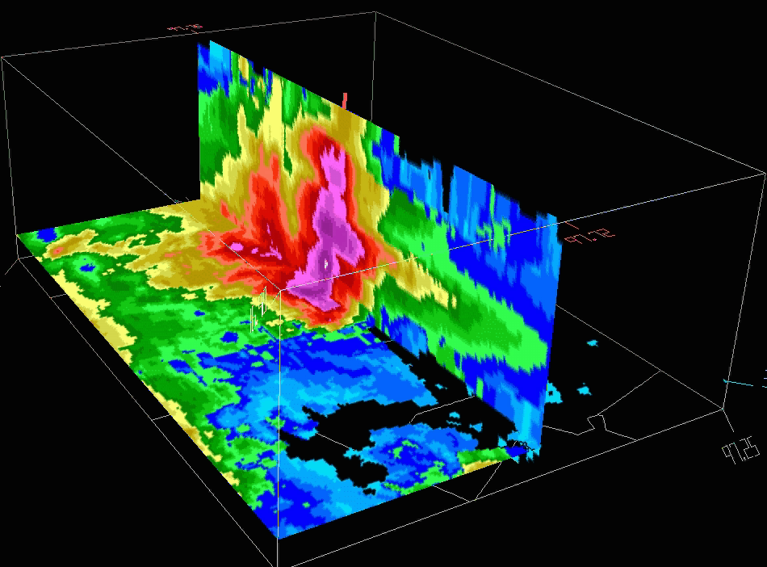
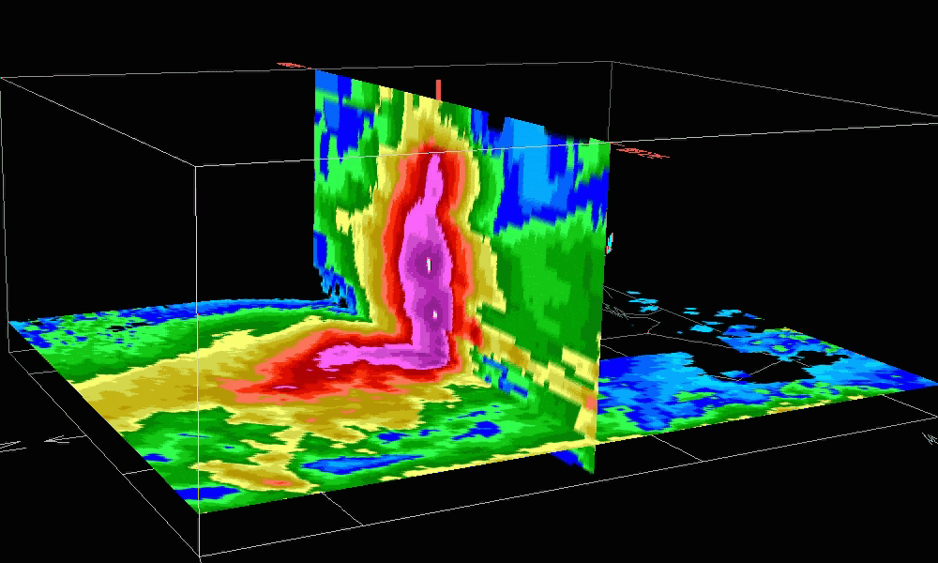
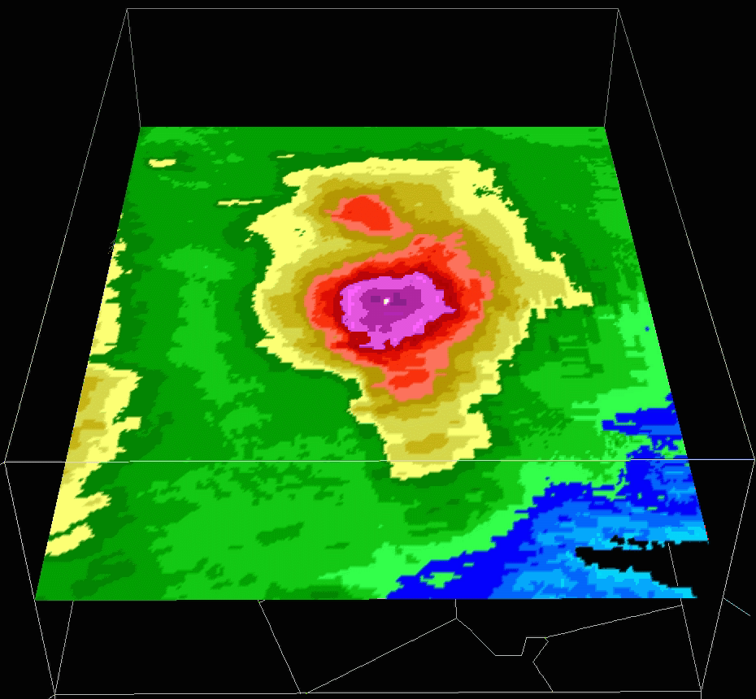
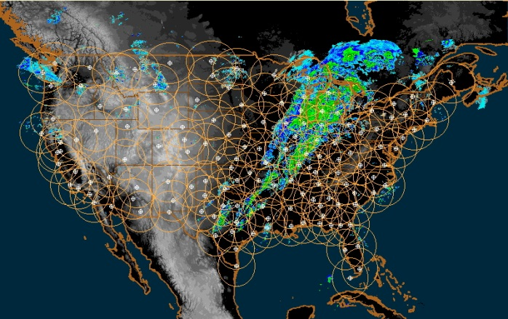
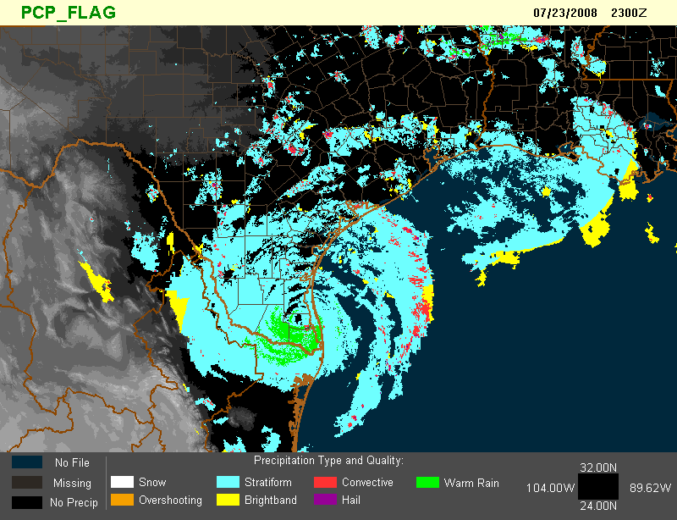
What is MRMS….
MRMS - Multiple-Radar / Multiple-Sensor
Multiple-Radar: Exploits the overlapping coverage of the WSR-88D, TDWR, Canadian networks and the base level real-time data feeds to build a seamless rapidly-updating high-resolution three-dimensional cube of radar data (moments).
Multiple-Sensor: Objectively blends data from the multiple-radar 3D sources with surface, upper air, lightning, satellite, rain gauges, and NWP environmental data, to produce highly-robust decision support products.

Slide 10
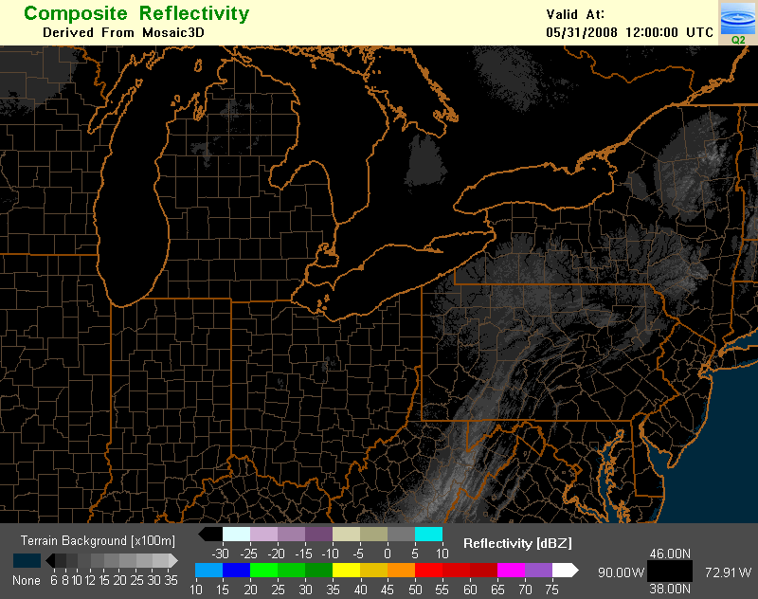
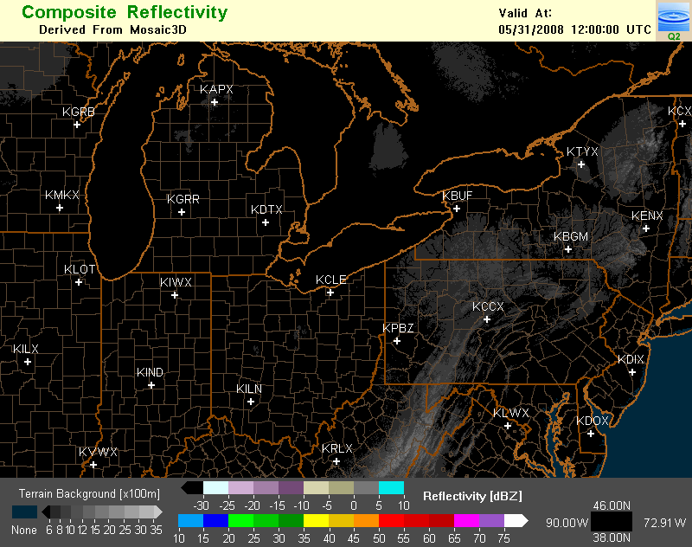
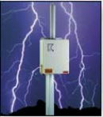
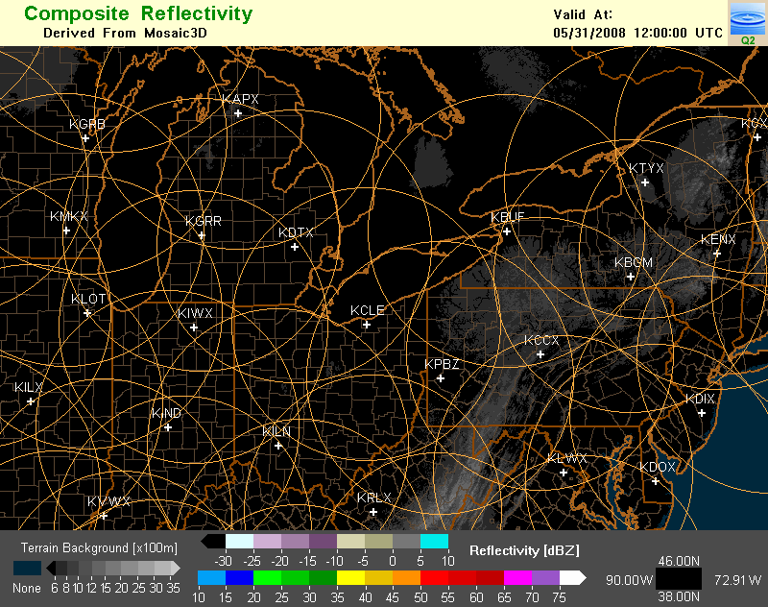

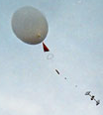
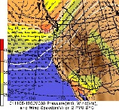
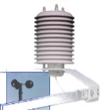
Integrated multiple sensor approach to high resolution rendering of storms and weather
Lightning
Radar Networks
Upper Air
Satellite
Models
Sfc Obs
NSSL MRMS System Briefing June 8, 2010
10
10
Notes:
10

Slide 11
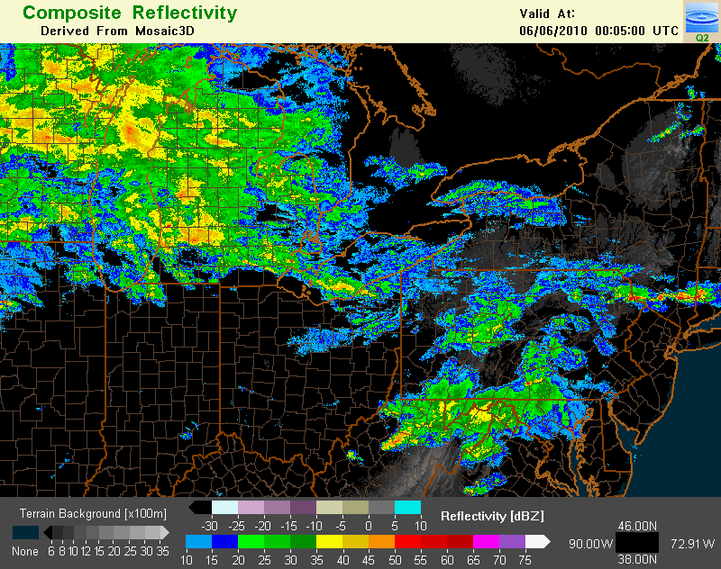
Integrated multiple sensor approach to high resolution rendering of storms and weather
Lightning
Radar Networks
Upper Air
InsertMRMS_Loop3
Satellite
Models
Sfc Obs
NSSL MRMS System Briefing June 8, 2010
11
11
Notes:
11

Slide 12
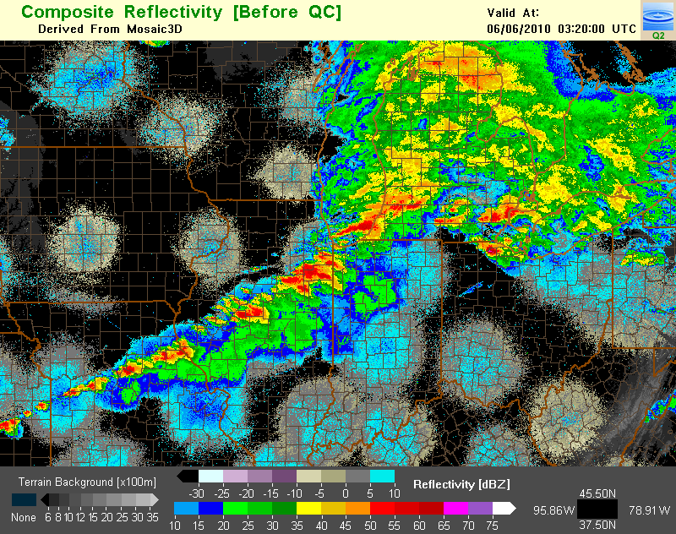
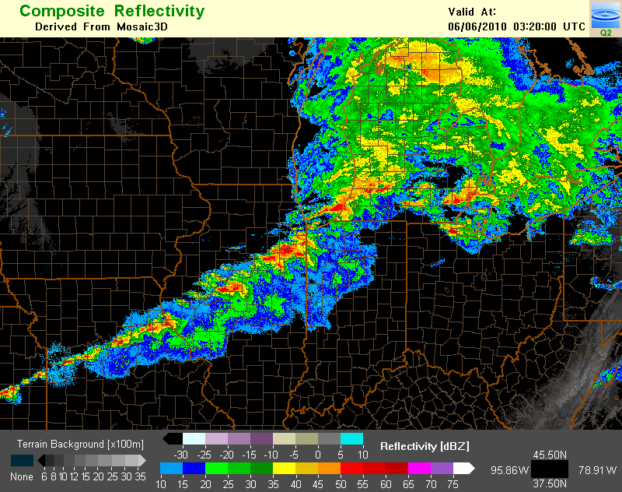
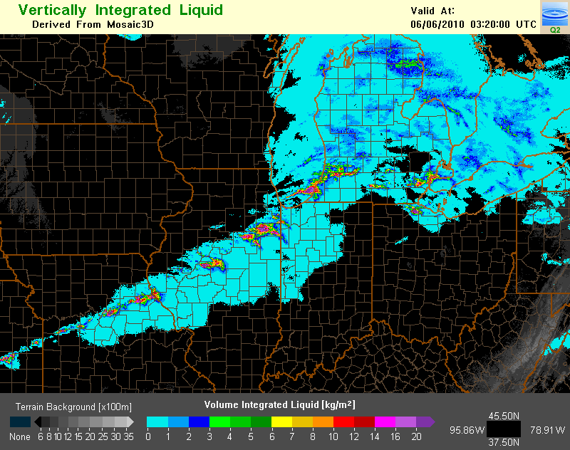
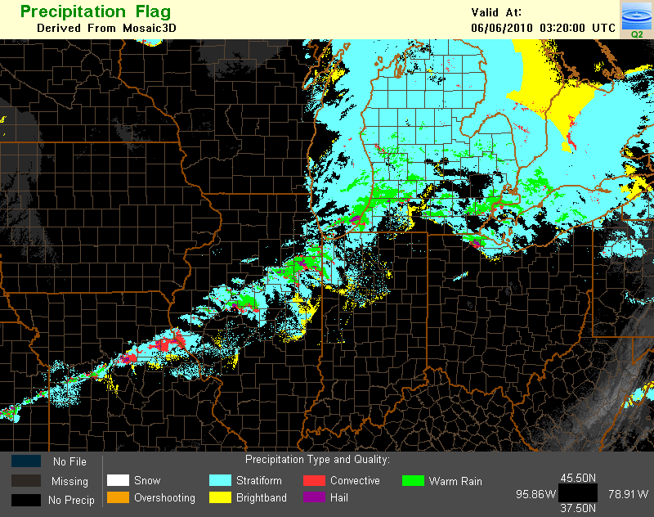
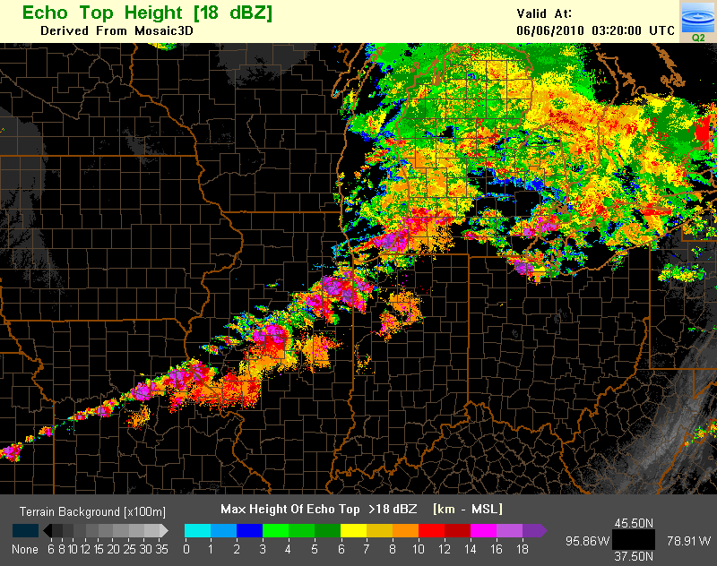
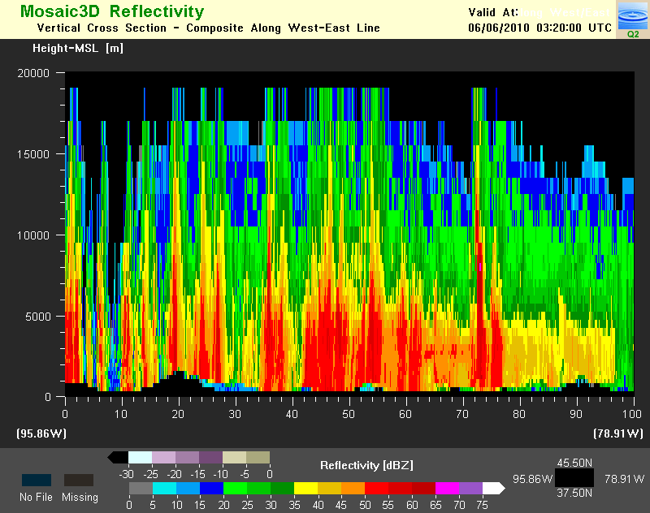
Integrated multiple sensor approach to high resolution rendering of storms and weather
Lightning
Radar Networks
Upper Air
Satellite
Models
Sfc Obs
NSSL MRMS System Briefing June 8, 2010
12
12
Notes:
12

Slide 13
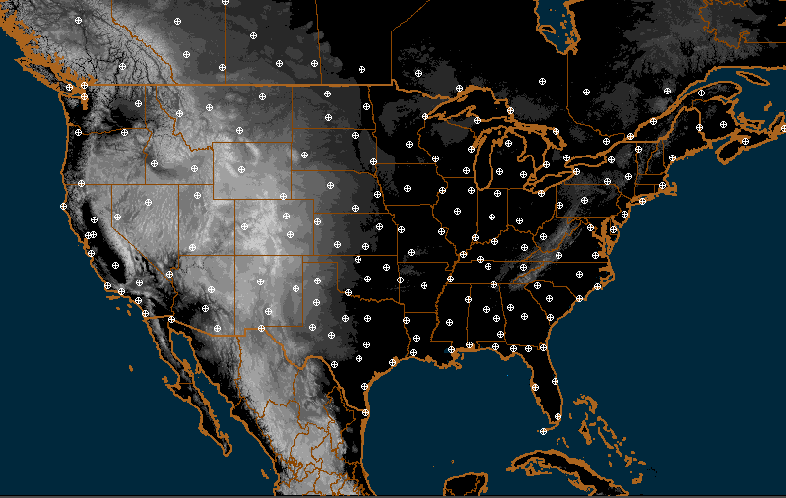
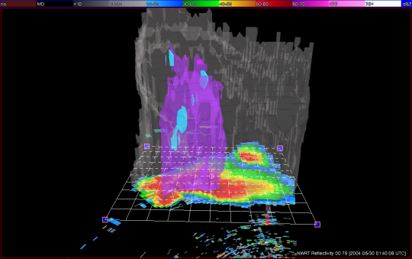
MRMS Domain
~140 WSR-88D 31 Canadian 15 TDWR 1 TV station radar
Notes:
This is the domain map of the NMQ system.
Currently we are ingesting radar data from 140+ WSR-88Ds, 31 Canadian radars, 2 TDWRs, and 1 TV station.
And the software design is modularized and is flexible for ingesting any new radar data such those from CASA.

Slide 14

MRMS Usage
The weather and climate enterprise has been utilizing MRMS products, in some form, for well over decade.
NCEP uses the radar mosaics at the Storm Prediction Center, the Aviation Weather Center, and the Weather Prediction Center for real‐time hazardous weather forecasting and post‐event data analysis.
MRMS 3D products are used to initialize and verify high‐resolution storm‐scale models such as the RR and HRRR.
The MRMS system is a component of a larger, multi‐agency effort to create a new, state‐of‐the‐art 3D storm‐scale analysis capability.

Slide 15
MRMS Transition to NWS Operations
Approval of the MRMS as an official NOAA Line Office Transition Project (December 2010)
Transition managed by NextGen Weather Program office (May 2013)
MRMS transition charter signed (August 2013)

Slide 16
MRMS Operational Transition Milestones
Program Phase/Milestone End
Finalize plan for MRMS product dissemination 06/2014
Establish Subversion MRMS source code repository at NCEP 01/2014
Test MRMS on primary NCEP compute farm 01/2014
Install and test MRMS IOC products on WJHTC MRMS System 03/2014
Install and test MRMS IOC system on primary NCEP compute center 07/2014
Verify MRMS test products are received at remote test sites 08/2014
MRMS IOC at College Park with products available operationally 09/2014
Refine performance and make adjustments to product creation/dissemination 11/2014
MRMS FOC - Entails installing software on backup compute center (Boulder) 04/2015

Slide 17
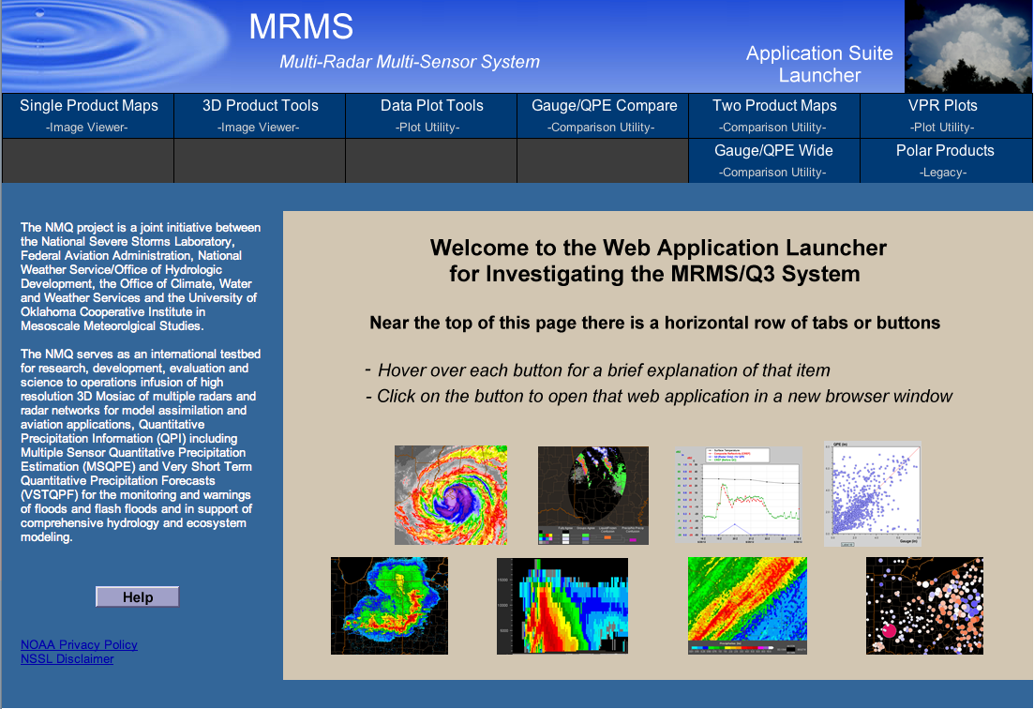
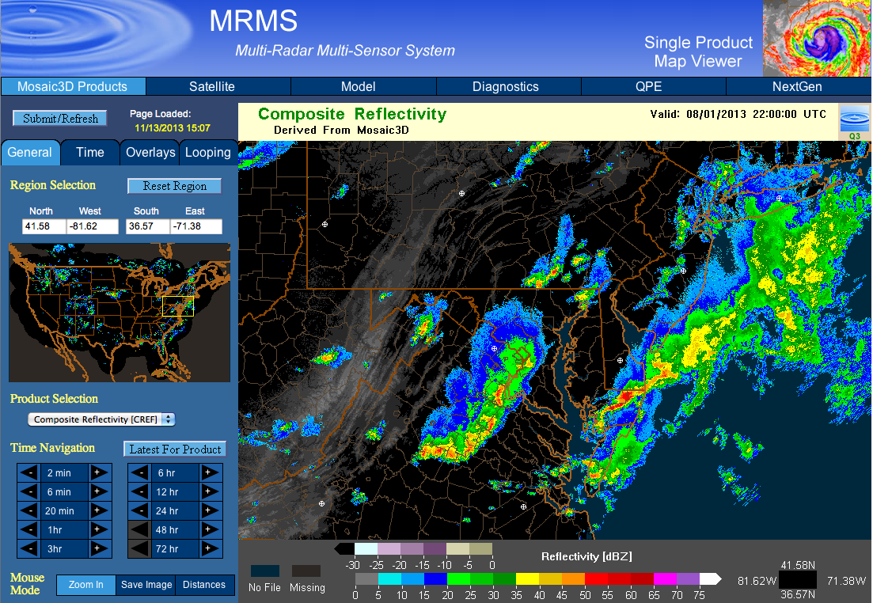
MRMS Web Page (nmq.ou.edu)

Slide 18
MRMS Summary
Provides, seamless, high resolution data sphere of integrated radar and sensor data for multiple agencies
Improves depictions of convective initiation, structure, and evolution for warnings, forecasts, air traffic routing
Provides framework for research and development for aviation related products via WJHTC MRMS system
Will provide an analysis of record to more robustly understand severe weather and precipitation climatologies nationwide
Will strengthen existing and establish new partnerships with multiple development and operational agencies
Will save lives, property, aviation delays/accidents

Slide 19
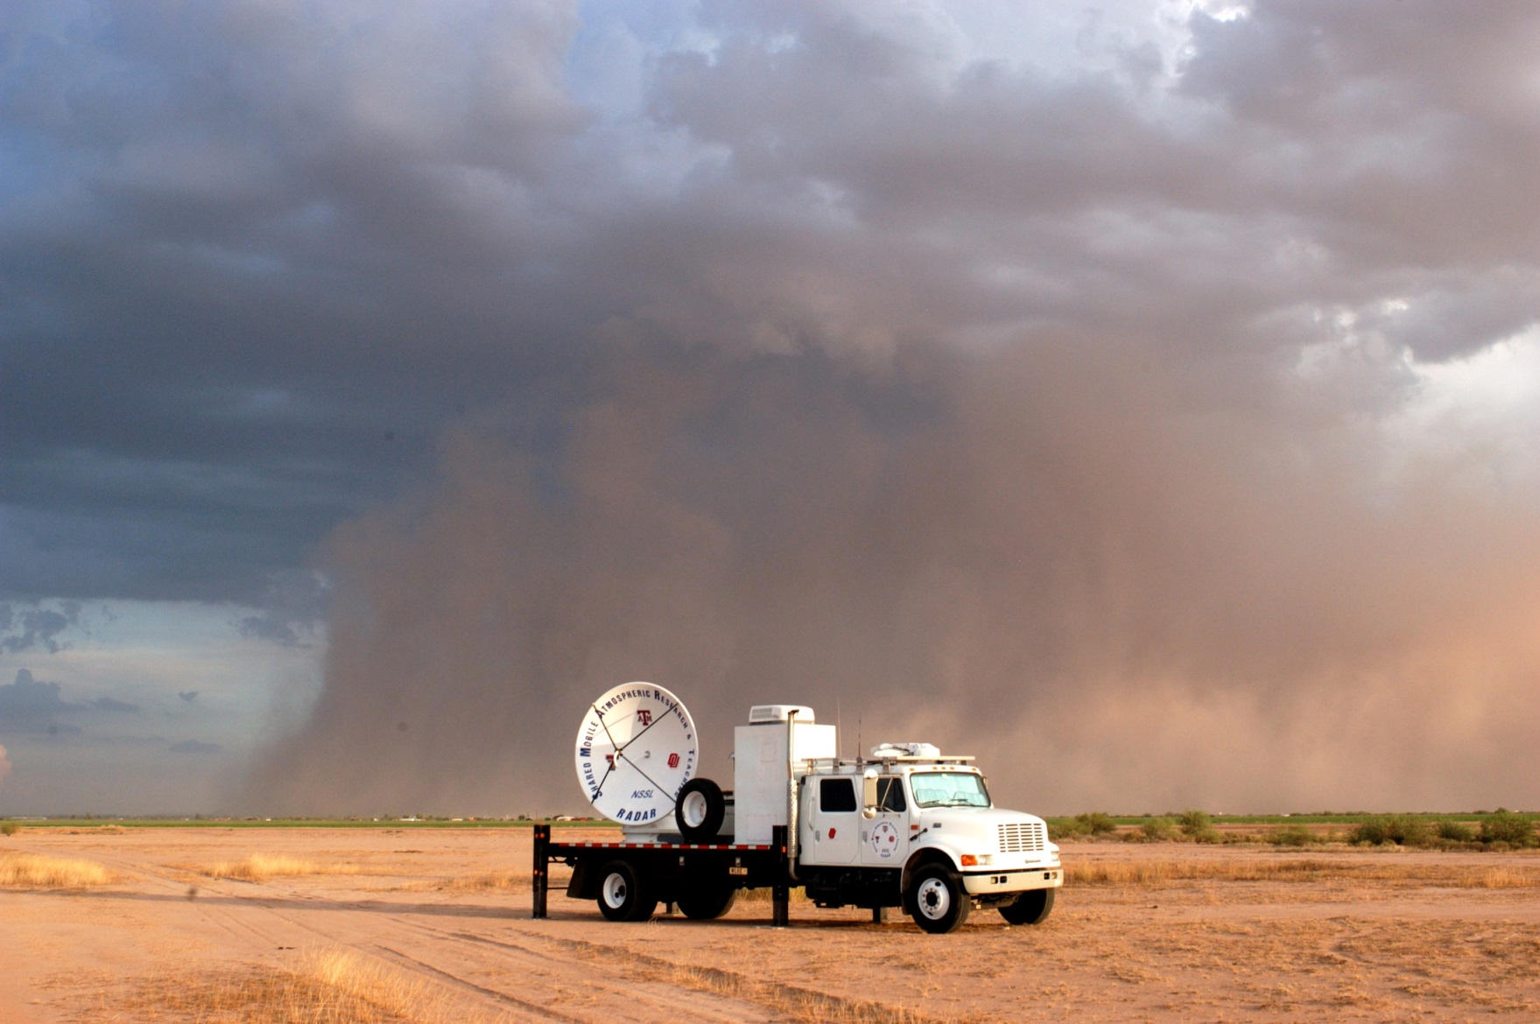
Questions

Slide 20
Back-up

Slide 21
Current MRMS R&D
QC study of the Canadian radar and other candidate radar networks. Data quality issues associated with non-WSR-88D radar networks require continued research and development for optimum quality assurance for the data to be fully integrated into the seamless 3D mosaic and derivative products. This effort benefits those forecast capabilities that rely on high fidelity radar imagery as an input (HRRR, CIP, GTG, CoSPA).
Utilize polarimetric radar techniques to further improve radar data quality control. The polarimetric radar variables have shown to provide more accurate identification of anomalous propagation, sea clutter, biological scatterers, and chaff echoes than using single-polarized radar variables. Better identification and removal of non-weather echoes will increase airspace capacity. DELIVERED
Integrate polarimetric radar variables with atmospheric environmental data and develop robust algorithms to identify different cloud and precipitation types (e.g., liquid vs. frozen, supercooled water vs. ice crystals, etc.). Accurate delineation of different hydrometeor regions could be beneficial to the TAIWIS and In Flight Icing PDTs.

Slide 22
Current MRMS R&D
Evaluating performances of the polarimetric radar hydrometeor classification algorithm (HCA) for different seasons and different geographical areas, and develop strategies for seamless mosaicing of the HCA products for the CONUS domain. A high-resolution 3D national mosaic of cloud hydrometeor types (e.g., rain droplets, hail, ice crystal, etc) will be very useful for en route air traffic controllers. Further, the 3D HCA mosaic will be helpful for validation and improvements of various microphysical schemes used in numerical weather prediction models.
Continue supporting the MRMS system at the WJHTC and develop new techniques and products based on requirements from the aviation community. Continue to provide MRMS products to other AWRP PDTs and develop new techniques and products based on requirements from other AWRP PDTs.

